Slide 1
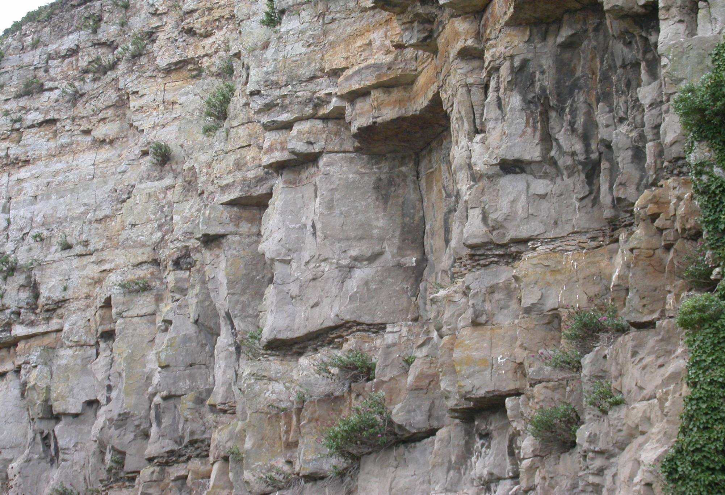
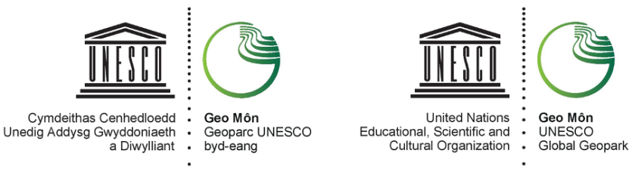
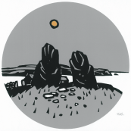
CLIMATE CHANGE
A Presentation from
GEOMÔN
UNESCO GLOBAL GEOPARK
GEOMÔN

Slide 2

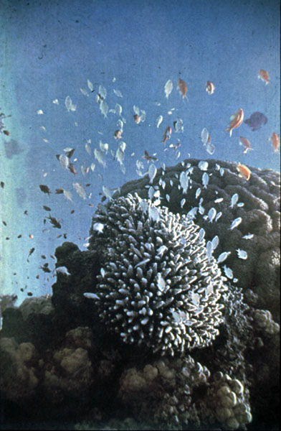
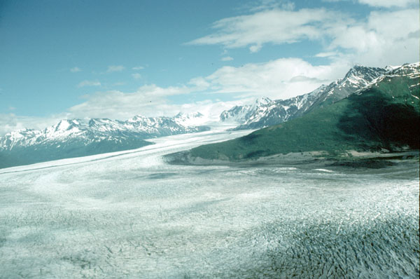
EXTREME CLIMATE CHANGE IN THE GEOLOGICAL PAST:
EVIDENCE FROM THE ROCKS OF ANGLESEY
GEOMÔN

Slide 3
Climate change is the major issue confronting human society.
Global temperature is rising because of increasing levels of greenhouse gases in the atmosphere.
This is largely due to human activity.
But climate change has been a frequent phenomenon throughout Earth history driven by natural causes.
The evidence for this is found in rocks.
On the Isle of Anglesey we can find evidence for extreme climate change in both the distant and recent geological past.
GEOMÔN

Slide 4
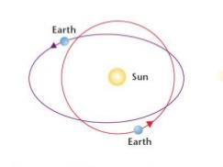
NATURAL CAUSES OF CLIMATE CHANGE
CLIMATE CHANGE MAY BE GLOBAL OR REGIONAL
1 GLOBAL due to variations in the amount of heat energy in the atmosphere
reaching the Earth from the Sun (e.g. changing distance between Earth and Sun).
retained by the atmosphere (e.g. increasing greenhouse gases ).
exchanged between the Earth’s surface and atmosphere (continental drift changes the distribution of the continents and the ocean basins).
GEOMÔN

Slide 5
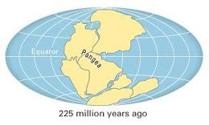
NATURAL CAUSES OF CLIMATE CHANGE
CLIMATE CHANGE MAY BE GLOBAL OR REGIONAL
2 REGIONAL due to the geographical position and topography of the continents
The distribution of the continents changes due to continental drift and a region moves from one climate zone to another
A new mountain belt is created by the collision of continents which changes regional weather patterns
GEOMÔN

Slide 6
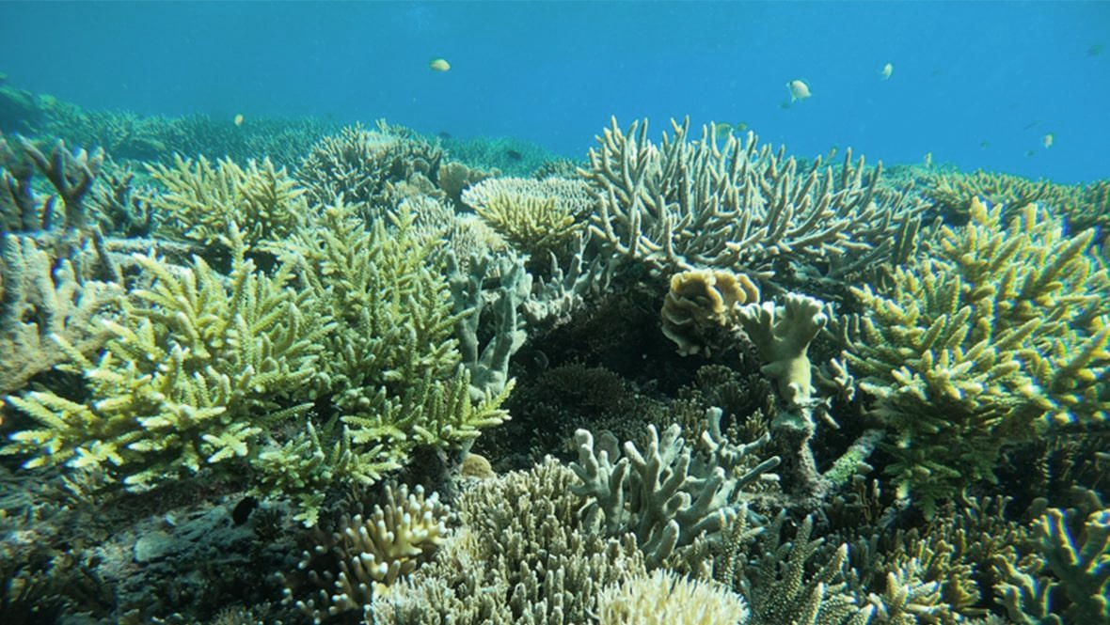
An example of a regional climate change due to continental drift
THE CARBONIFEROUS LIMESTONE
GEOMÔN

Slide 7
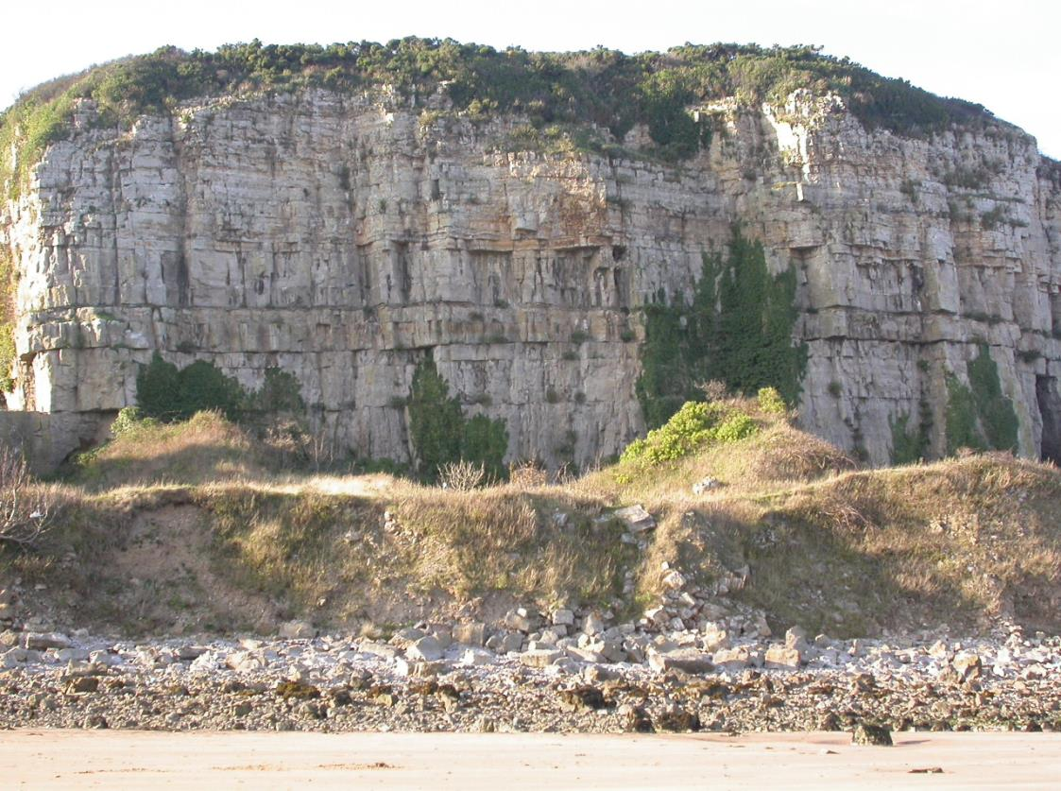
This is a limestone in Red Wharf Bay that formed in the Carboniferous Period –
350 million years ago
The limestone is composed mostly of calcium carbonate
It was deposited in a shallow sea when the climate was tropical
How do we know?
GEOMÔN

Slide 8
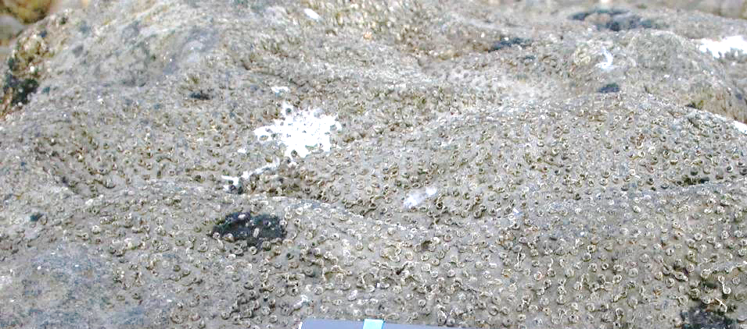
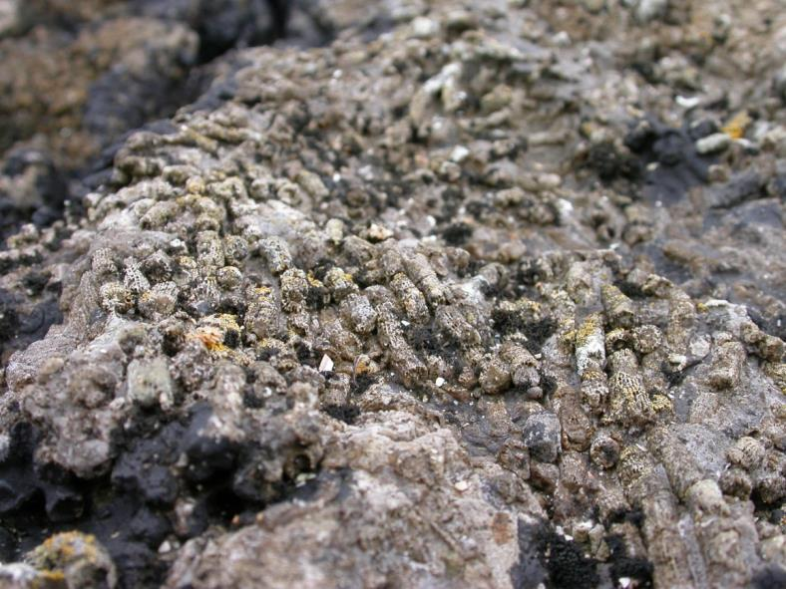
The limestone contains the fossils of CORALS that built coral reefs
Reef-building corals live only in tropical and subtropical climates because they need warm seas
The parts that are preserved are the theca – the solid chambers that were occupied by the coral polyps
GEOMÔN

Slide 9
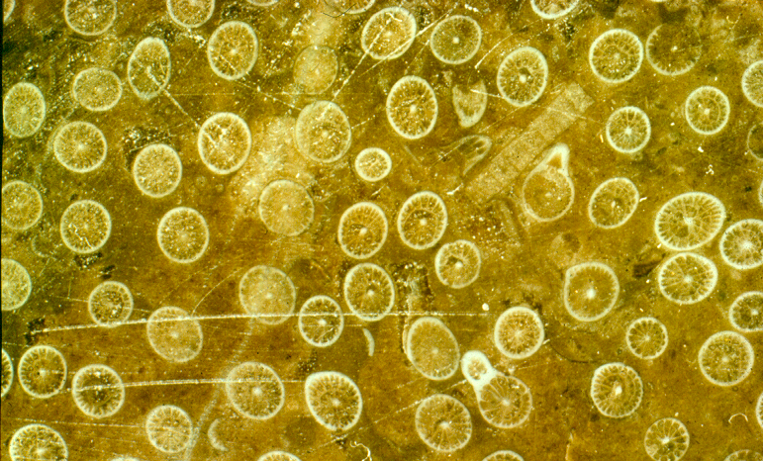
The coral in the limestone is the species called Lithostrotion
Each coral polyp in its theca contained symbiotic algae within its tissues
The algae – plants – utilised photosynthesis, using light energy for growth. This resulted in precipitation of calcium carbonate which the corals used to build the reef
This could occur only if the water temperature was high and there was sufficient light for photosynthesis by the algae
GEOMÔN

Slide 10
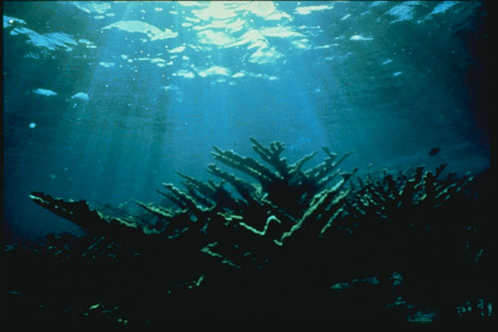
Reef-building corals need light so the symbiotic algae can photosynthesise and the corals can build the reef
The presence of corals in the Carboniferous Limestone proves that the limestone formed in a shallow sea (<40 m) where sufficient light could reach the seabed
GEOMÔN

Slide 11
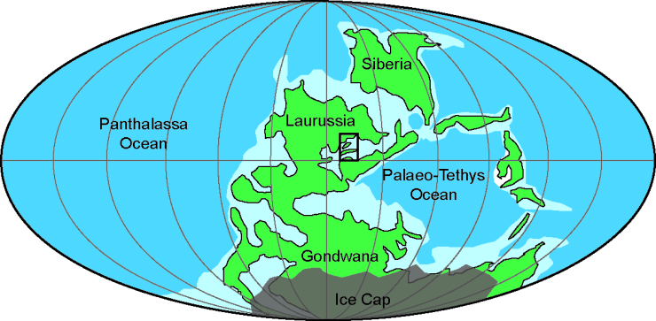
The UK
Note how the continents were clustered together
In the Carboniferous Period, average global temperatures were 20ºC (compared with 14ºC in the 20th century)
What is now the UK was near the equator as a result of continental drift
So the UK climate was tropical monsoonal – like present-day Indonesia – and coral reefs were abundant
GEOMÔN

Slide 12
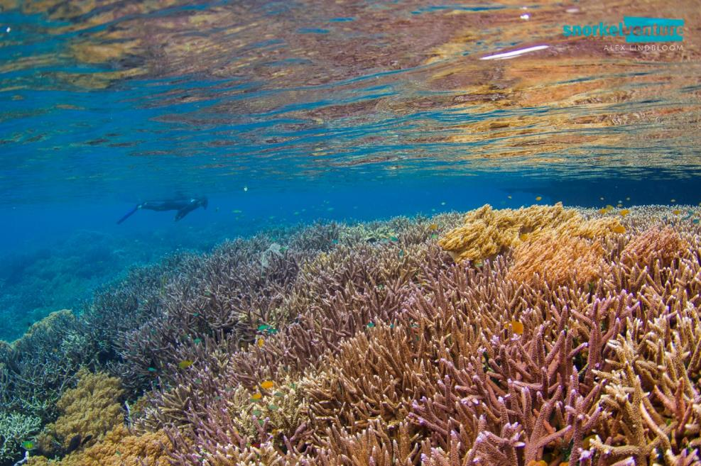
Large ice sheets at the South Pole were melting which caused a global rise of sea level
Large swathes of land were flooded by the sea and this created an extensive shallow sea (largely less than 40 m deep) that extended from the Rhine to Kansas (Europe and North America were joined together in the Carboniferous Period)
So coral reefs – like these modern reefs in Indonesia – were widespread
GEOMÔN

Slide 13
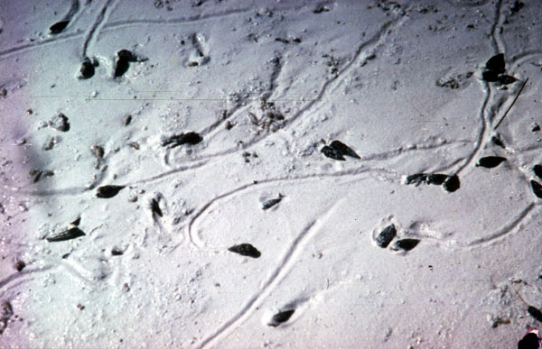
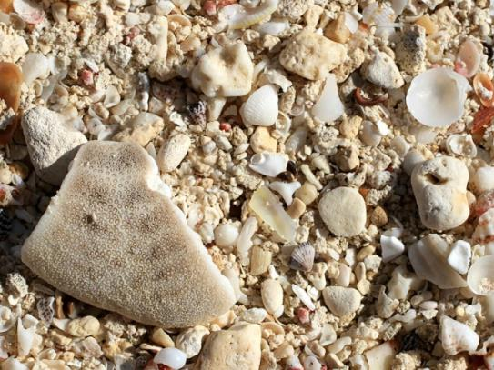
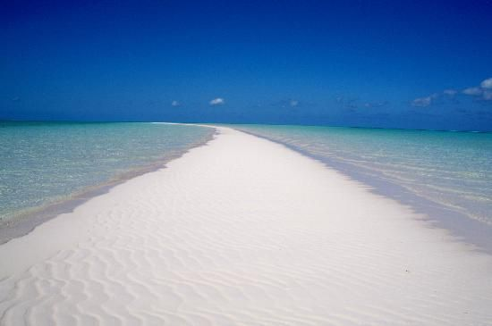
The coral reefs and shallow lagoons hosted abundant other shelly organisms most of which built their shells from calcium carbonate
Whole and broken shells from these organisms accumulated as sediments on the seabed
The whole region was dominated by white carbonate sands derived from marine organisms
Such sediments are found today in regions like the Bahamas, Florida and Bermuda as in these pictures
GEOMÔN

Slide 14
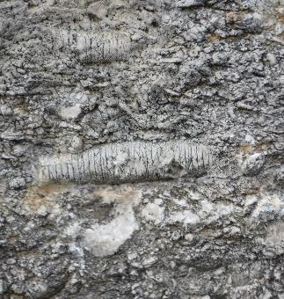
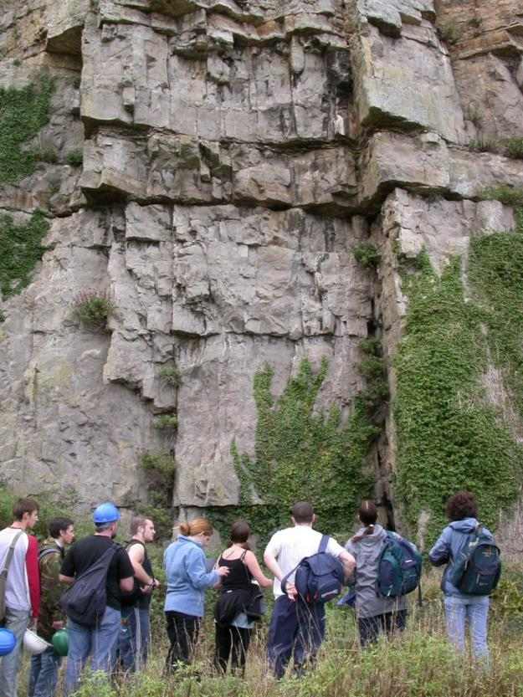
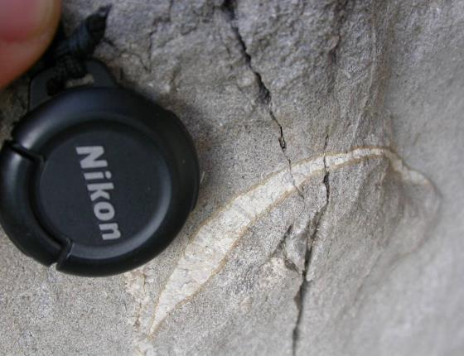
The carbonate sediments were later transformed into the Carboniferous Limestone
Fossils – fragments of the shells of the molluscs and crinoids which made up the sediments – are common
GEOMÔN

Slide 15
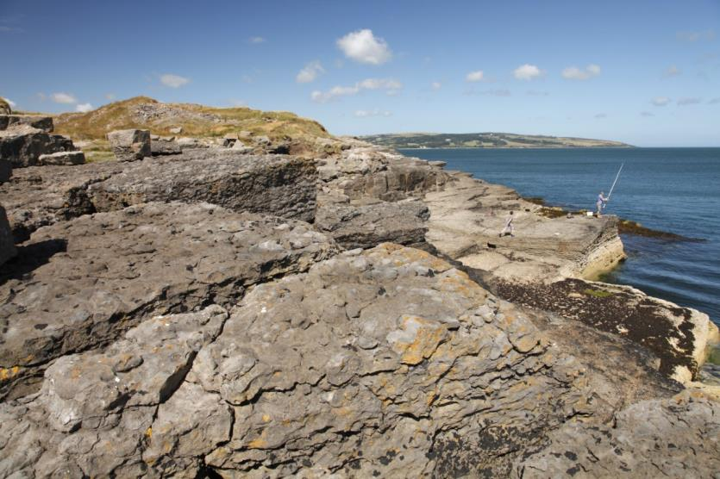
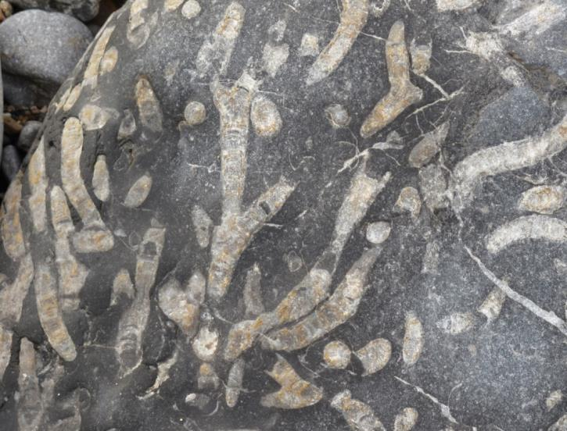
Photos: Stewart Campbell
The same Carboniferous Limestone with corals is beautifully exposed along the coastline between Lligwy and Moelfre on Anglesey
GEOMÔN

Slide 16
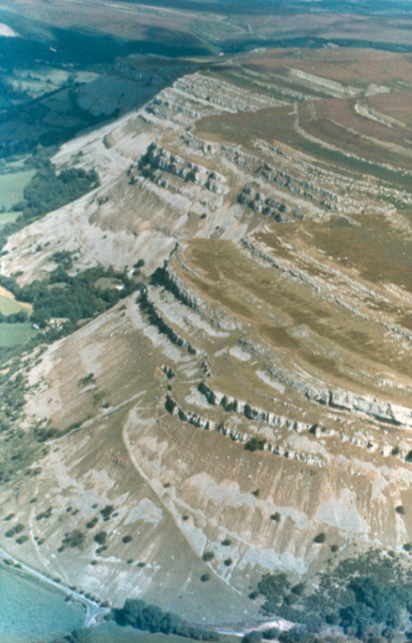
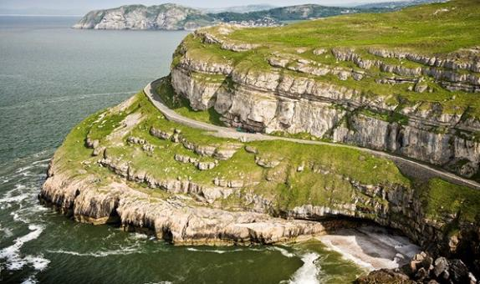
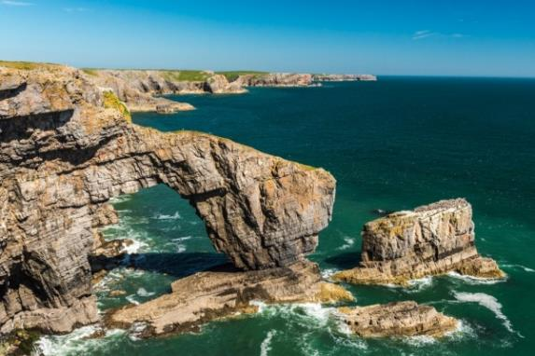
Great Orme’s Head, Llandudno
The Carboniferous Limestone can also be seen elsewhere in Wales and in other parts of the UK as well as in Europe and North America
The shallow coral seas were very extensive and reefs thrived for millions of years
Green Bridge of Wales, Pembrokeshire
Vale of Llangollen
GEOMÔN

Slide 17
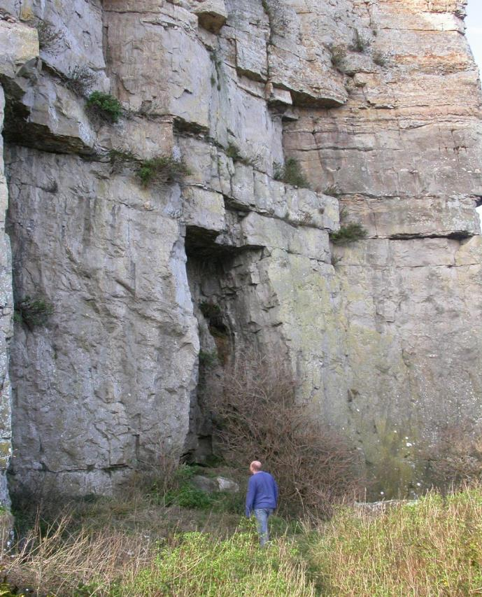
To summarise
The Carboniferous Limestone was the result of climate change due to continental drift
Continental drift moved the UK into a region with a tropical climate
The Earth as a whole was 6ºC warmer in the Carboniferous Period than now
GEOMÔN

Slide 18
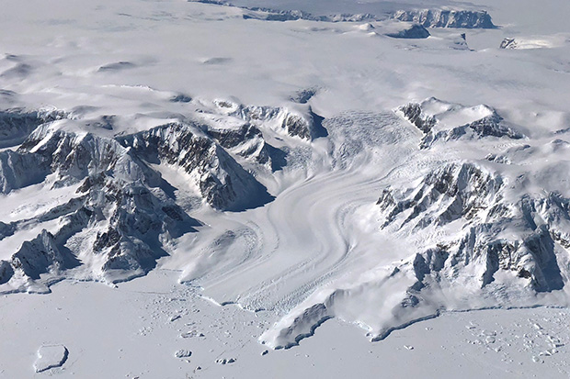
An example of a global climate change due to a decrease in solar energy reaching the Earth
THE BOULDER CLAY
GEOMÔN

Slide 19
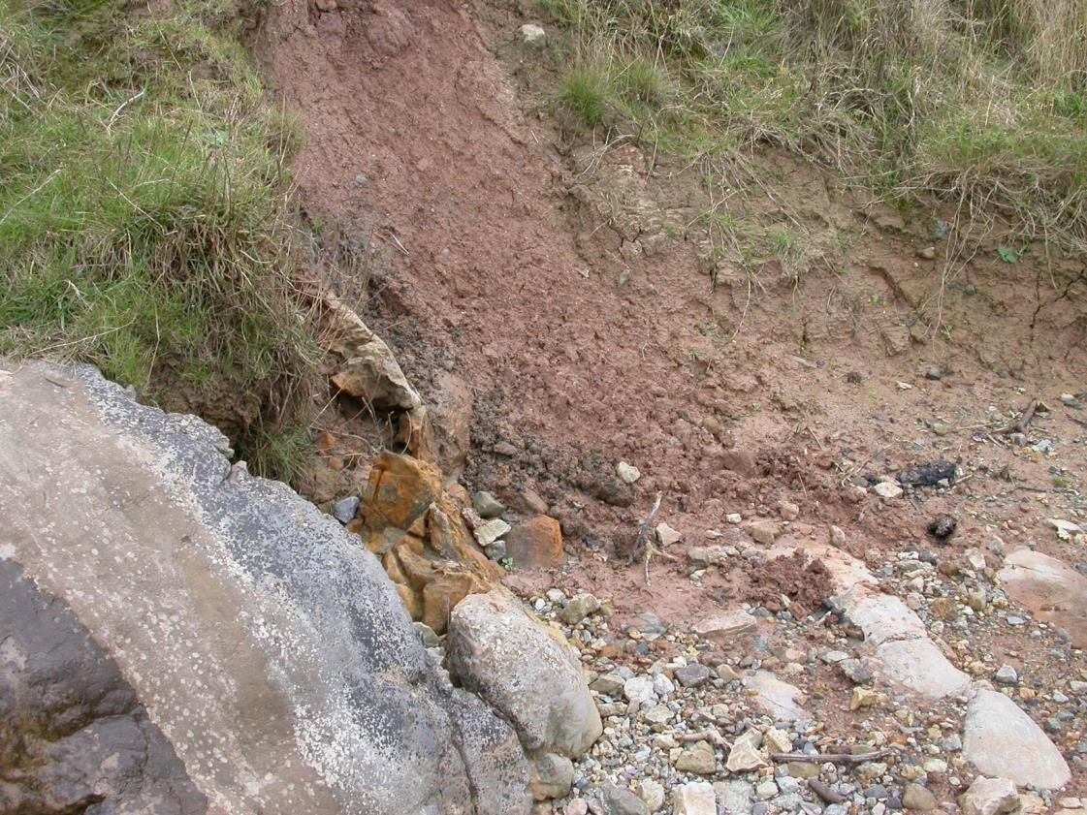
Next to the Carboniferous Limestone in Red Wharf Bay is this nondescript deposit which is nevertheless equally rich in evidence of climate change
It’s called Boulder Clay and was deposited by a retreating glacier during the Quaternary Period (2.6 million years ago to the present)
GEOMÔN

Slide 20
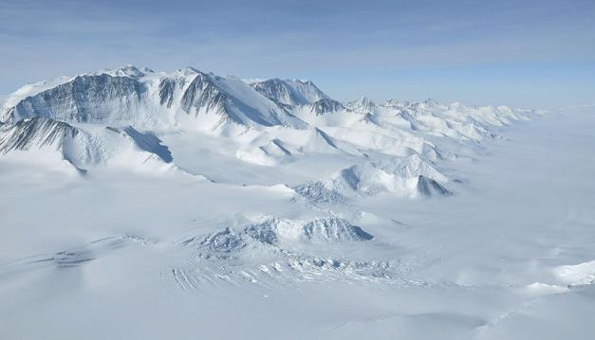
The boulder clay is a geological formation diagnostic of an extreme cold climate – GLACIAL
The Quaternary Period started 2.6 million years ago and has been characterised by extreme climatic fluctuations with 5 major periods of intense cold that generated extensive glaciers and ice sheets
Evidence for the last cold period can be seen on Anglesey
How do we know?
GEOMÔN

Slide 21
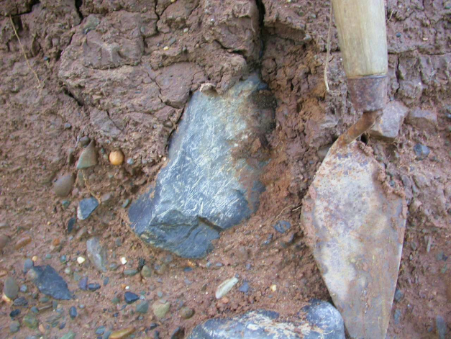
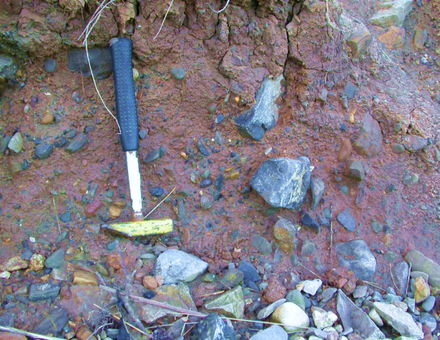
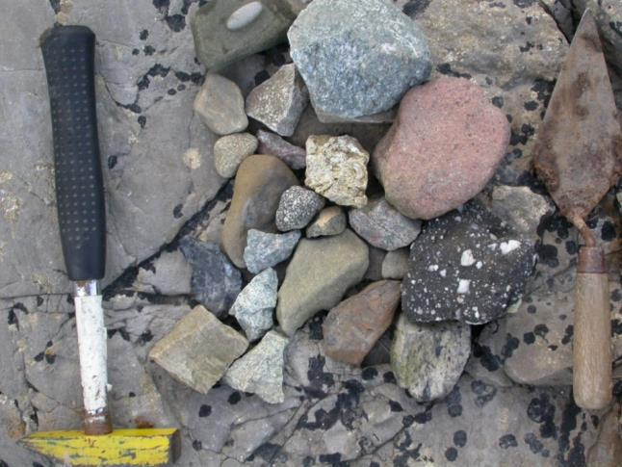
The Boulder Clay contains fragments of rocks that do not occur in North Wales. Some fragments came from the North of England.
The clay component is a reddish colour – derived from red rocks that occur beneath the seabed of the Irish Sea
GEOMÔN

Slide 22
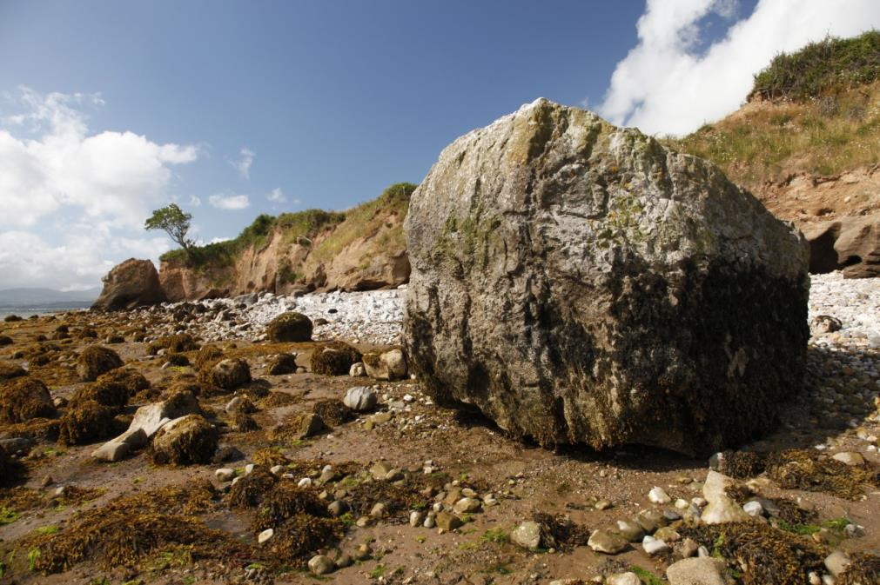
Some of the boulders – called erratics - are much too big to have been transported by water
This one is on the shore of the Menai Strait.
The Boulder Clay on Anglesey was deposited by a melting ice sheet that had originally advanced from the northern UK southwards across the Irish Sea (which was dry). Smaller glaciers from Snowdonia also moved across Anglesey
Photo: Stewart Campbell
GEOMÔN

Slide 23
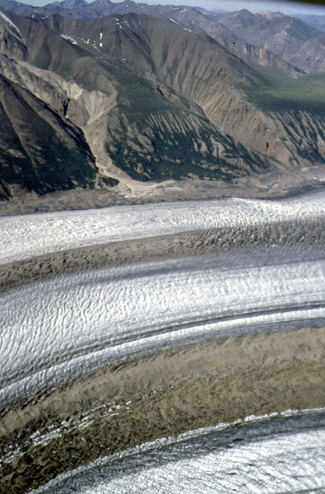
Glaciers erode the underlying bedrock as they move across the land. They enlarge valleys – textbook examples can be seen in Snowdonia – and they carry large quantities of eroded material
When the ice melts, and the glacier retreats, this eroded material is dumped as a mixture of rock fragments and clay
This is how the Boulder Clay formed
Identification of the rock fragments in the Boulder Clay allows geologists to reconstruct the movements of the ice sheet
GEOMÔN

Slide 24
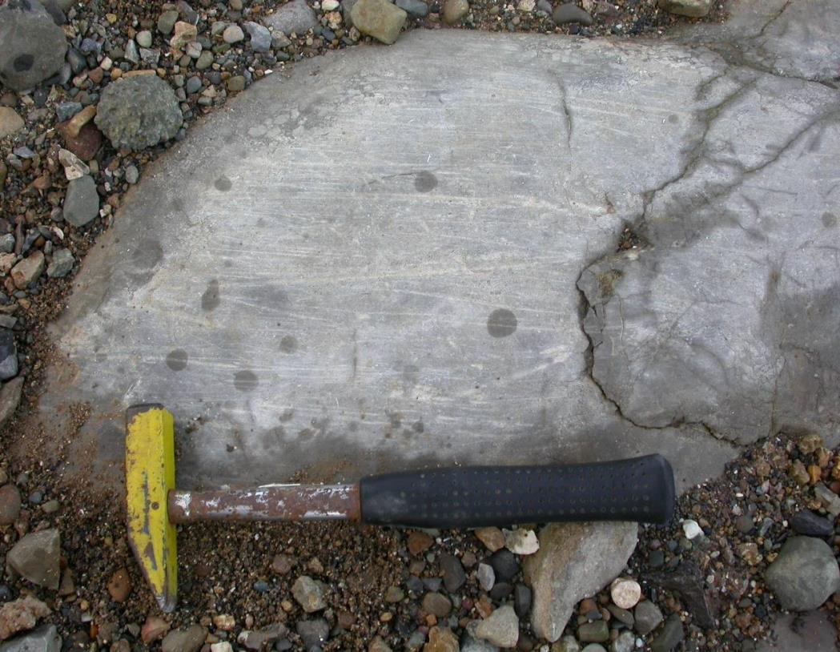
The Quaternary ice sheets were thick – up to 1 km thick in the northern parts of the UK.
As they advanced the ice sheets gouged the underlying bedrock, creating striations that provide additional evidence of the direction of ice movement
These striations in Red Wharf Bay are cut into the much older Carboniferous Limestone. They have become exposed by recent erosion of the Boulder Clay by waves. The best striations are often seen after the winter when fresh, striated limestone has been exposed by storms.
GEOMÔN

Slide 25
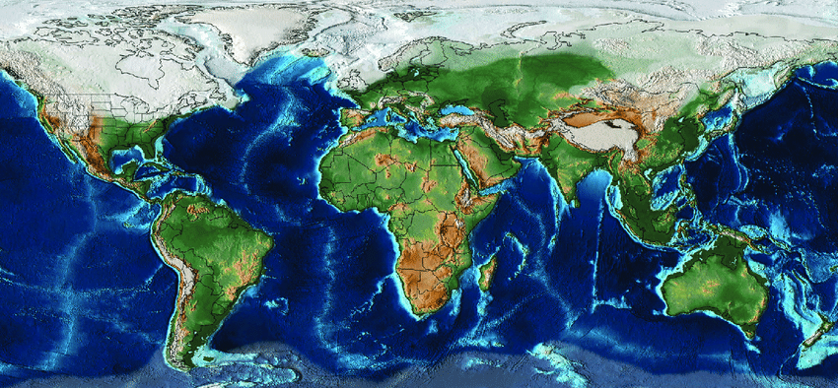
During the last glacial maximum, about 27,000 years ago, high latitudes in the Northern Hemisphere were dominated by thick ice sheets
Mean global temperature was 8ºC compared with 14ºC in the 20th century and 20ºC in the Carboniferous Period
The global cooling was caused by a reduction in the amount of solar energy reaching the Earth because of changes to the Earth’s orbit and orientation with respect to the Sun
GEOMÔN

Slide 26
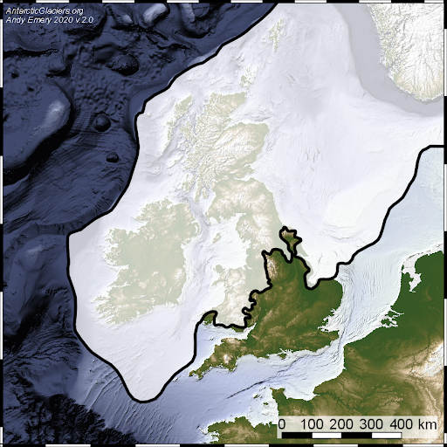
Most of Wales was covered by an extensive ice sheet
The nature of the fragments in the Boulder Clay and striations in the underlying bedrock provide important clues as to the
extent and movement of the ice sheet
The ice flowed from the north across the Irish Sea basin and across Anglesey
GEOMÔN

Slide 27
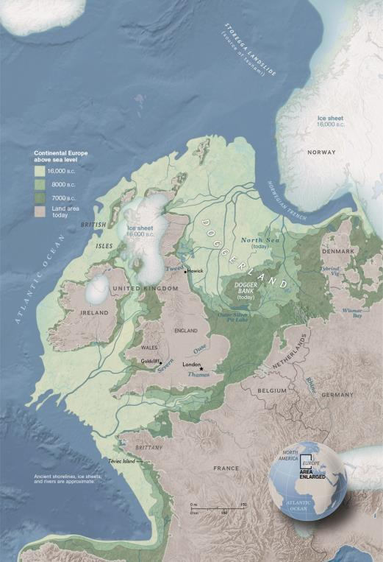
Global sea level fell about 140 m during the Ice Age
This was because the volume of ocean water decreased:
Normally water evaporates from the oceans, falls on the continents as rain, and returns to the oceans via rivers. During the Ice Age water fell on the continents as snow and accumulated as ice, so there was no return flow to the oceans. The oceans progressively lost water
The lowered temperature resulted in contraction of ocean waters
As a consequence, the Irish Sea was emptied of seawater so the ice sheet that flowed down the Irish Sea and across Anglesey was moving over dry land
The coastline 18,000 years ago
GEOMÔN

Slide 28
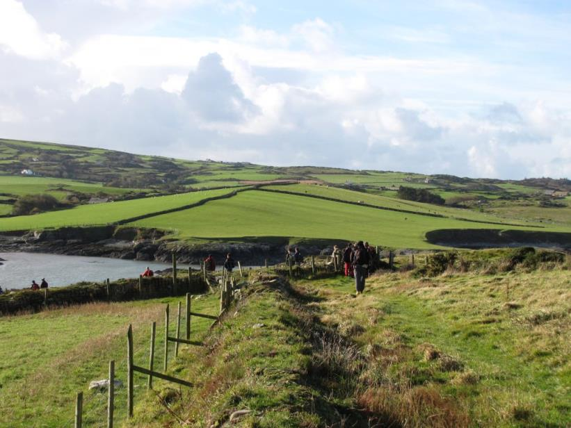
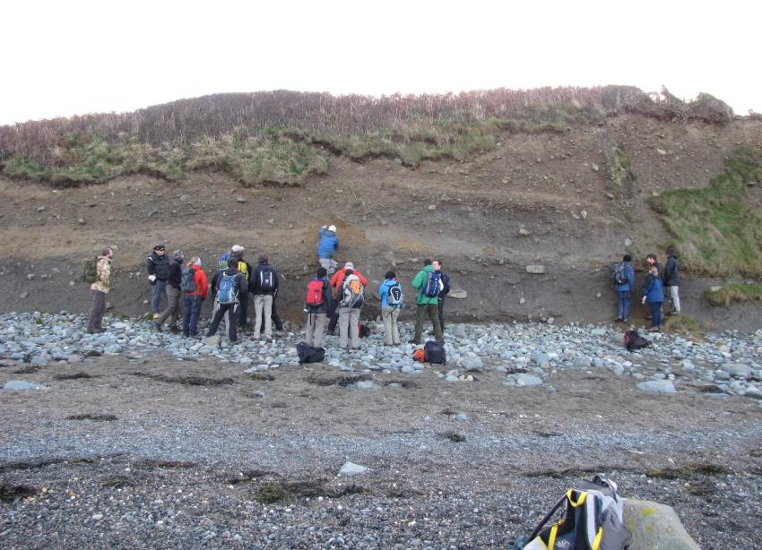
Photographs: Bethan Davies
The North Wales landscape is dominated by landforms left by the ice sheet
These can be erosional like the glaciated valleys of Snowdonia or depositional like these deposits (drumlins) on Anglesey
GEOMÔN

Slide 29
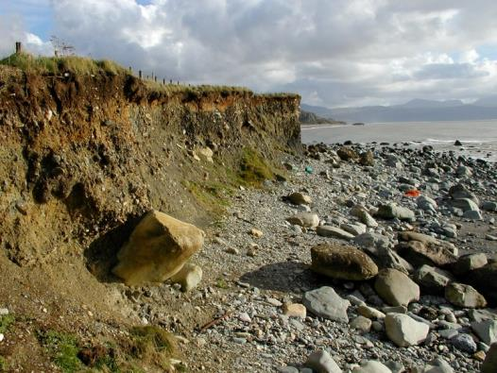
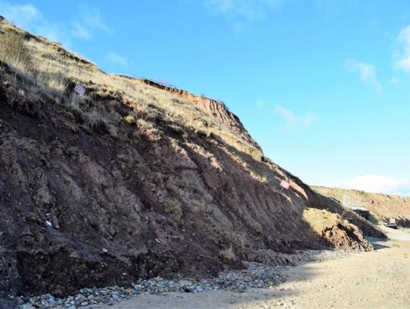
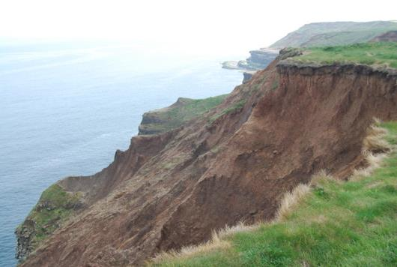
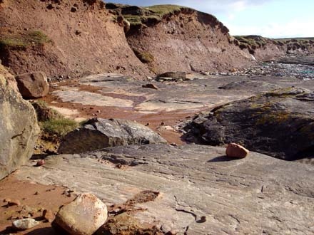
The Boulder Clay is widespread in Wales and the UK
Where it forms the coastline, there are usually serious coastal erosion issues as the formation is soft and easily eroded by waves and tides
This is an increasing problem as sea levels rise due to global warming
Criccieth
Holderness
Filey Brigg
Orkney
GEOMÔN

Slide 30
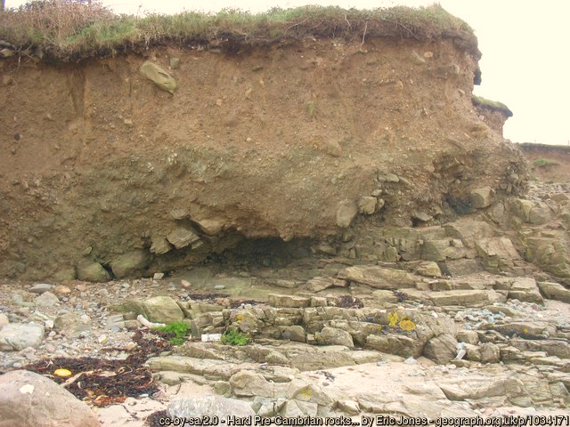
To summarise
The Boulder Clay resulted from climate change caused by a reduction in the amount of solar energy reaching the Earth
The Earth was 6ºC colder during the last glacial maximum than now
GEOMÔN

Slide 31
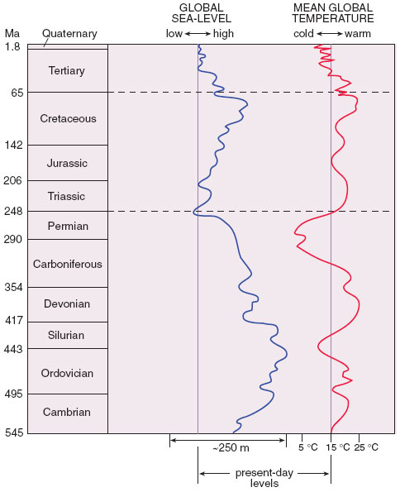
Boulder clay
Low temperature
Low sea level
Mean global temperature (red line) and global sea level (blue line) have varied over geological time
Global temperature can drive sea level change: high temperatures melt polar ice sheets and expand the volume of the oceans; low temperatures cause a sea level fall
Temperature is not the only factor that changes sea level
Millions of years before present
Carboniferous Limestone
High temperature
High sea level
GEOMÔN

Slide 32
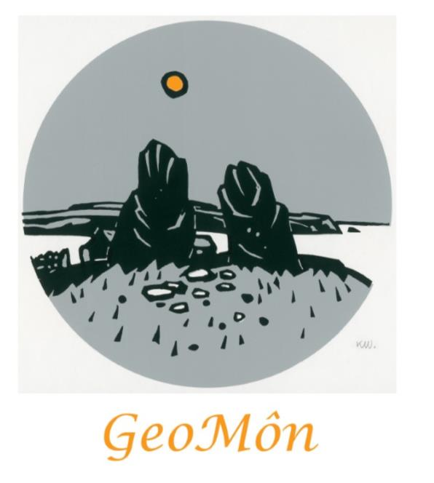
The Carboniferous Limestone and the Quaternary Boulder Clay are easily accessible on the Isle of Anglesey
For further information on where to see these geological formations and other interesting geological sites that tell the story of the Earth during 700 million years, please contact GeoMôn
We would love to hear from you
Website: http://geomon.co.uk
Email: college@btinternet.com
The GeoMôn UNESCO Global Geopark is one of 161 Geoparks in 44 countries. UNESCO Global Geoparks are single, unified geographical areas where sites and landscapes of international geological significance are managed with a holistic concept of protection, education and sustainable development.
Colin Jago, July 2020
GEOMÔN

